Slide 1
Project Management
PROJECT TIMELINE THROUGH GANTT CHART

Slide 2
What is a Gantt Chart?
Gantt charts are useful for planning and scheduling projects. They help you assess how long a project should take, determine the resources needed, and plan the order in which you'll complete tasks. They're also helpful for managing the dependencies between tasks.

Slide 3
The Gantt Chart view displays task information in two panels: the left panel displays information as a sheet and the right panel displays information as a chart.
Panel 1 displays the task information as a sheet and includes details about start and finish task dates, resources assigned to them or % complete.

Slide 4
The following columns are usually referred: Id, Indicators, Name, Duration, Start, Finish, Resource Names, Percent Complete, Predecessors.
Panel 2 displays the Gantt bar representation of the tasks. The bar's length and position on the timescale indicate when that task begins and ends. In addition, the position of one task bar in relation to another indicates whether the tasks follow one another or overlap.

Slide 5
Advance Features of a Gantt Chart
Time Management
Resource Allocation
Predecessors
Milestones
Critical Path
Work Load Distribution
Percentage Complete
Cost Management

Slide 6
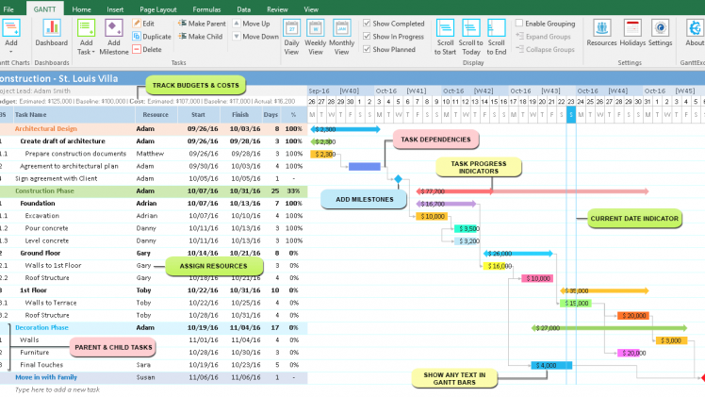

Slide 7
